Slide 1
Owner-occupied dwellings and imputed rent with Hedonic Regression
Asadh 13-14, 2081
Dr. Anil Shrestha
Undersecretary (Account)
Financial Administration Section
National Statistics Office

Slide 2
Owner-occupied Dwelling

Slide 3

What is Owner-occupied dwellings?
Housing units owned and lived in by the occupant.

Slide 4

Treatment in the SNA
Not directly included in GDP as it is not considered as part of the market activity.
Instead, SNA utilizes estimated rental value (imputed rent) that the owner would have to pay if they were to rent a similar property in the market.
As per SNA, the imputed rent is recorded in both consumption and production of housing services.

Slide 5
Hedonic Regression for imputed rent

Slide 6
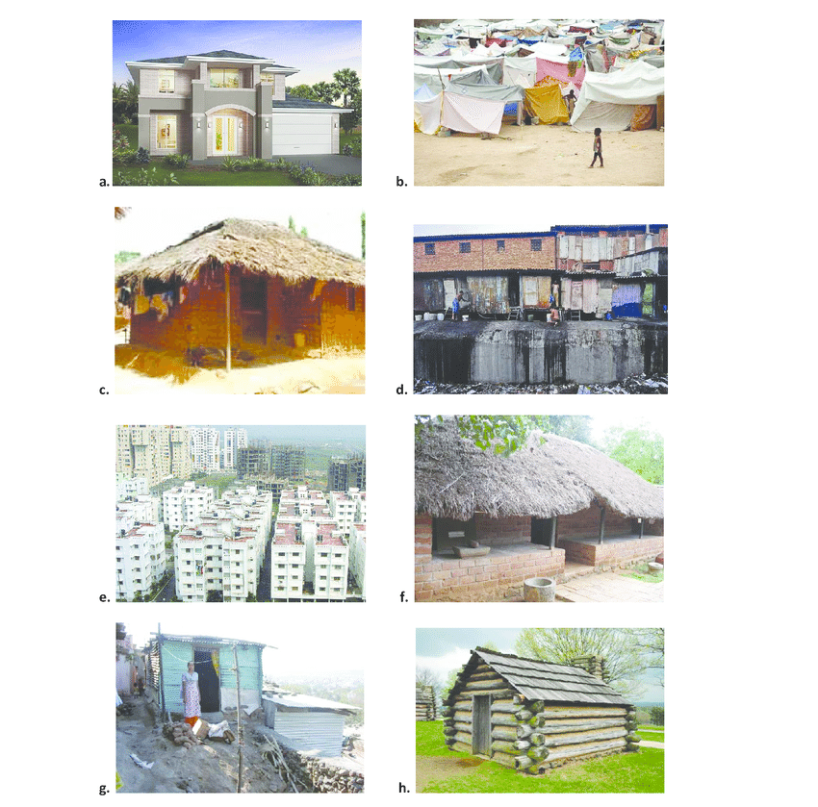
What is Hedonic Regression?
It’s a technique to estimate prices of an asset/a product/a service based on its underlying characteristics using an OLS model.

Slide 7
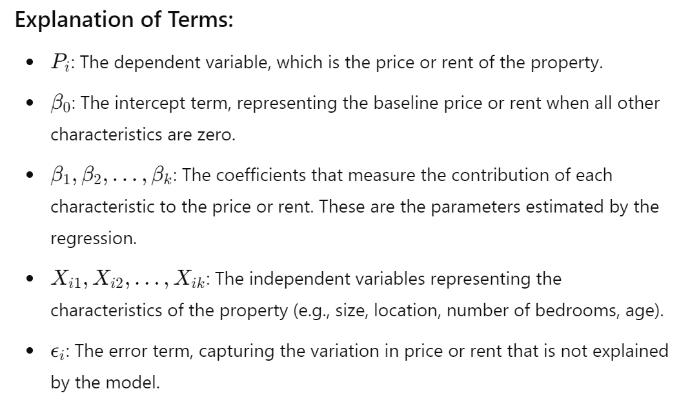
Basic Hedonic regression model

Slide 8
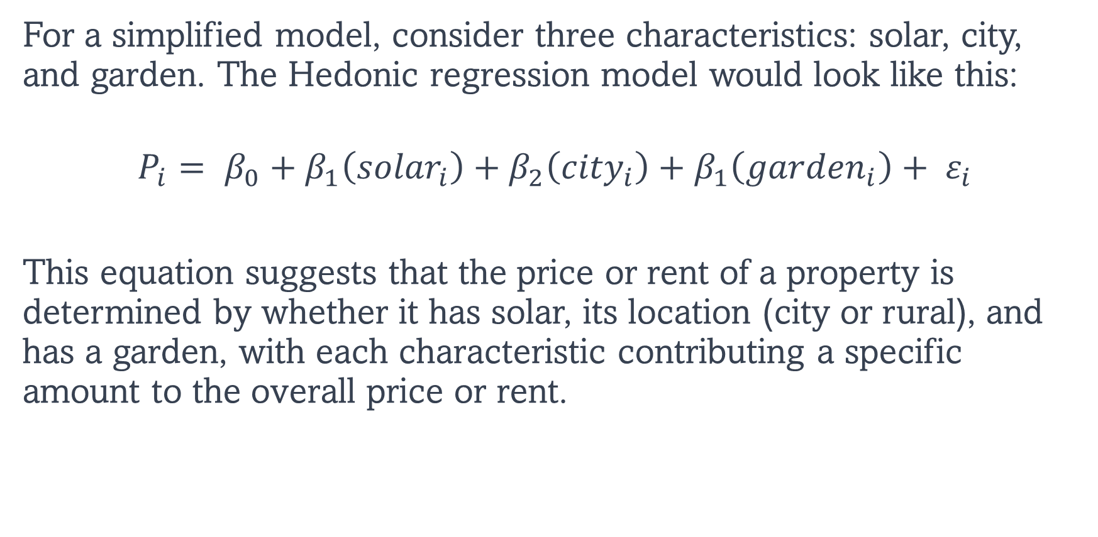
Example 1:
For a simplified model, consider three characteristics: solar, city, and garden. The Hedonic regression model would look like this:
$$P_{i}= β_{0}+β_{1}\left({solar}_{i}\right)+β_{2}\left({city}_{i}\right)+β_{1}\left({garden}_{i}\right)+ ε_{i}$$
This equation suggests that the price or rent of a property is determined by whether it has solar, its location (city or rural), and has a garden, with each characteristic contributing a specific amount to the overall price or rent.

Slide 9
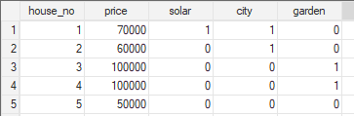
Example housing price data
All the data, example codes, and do files are provided in https://s.anilz.net/training

Slide 10
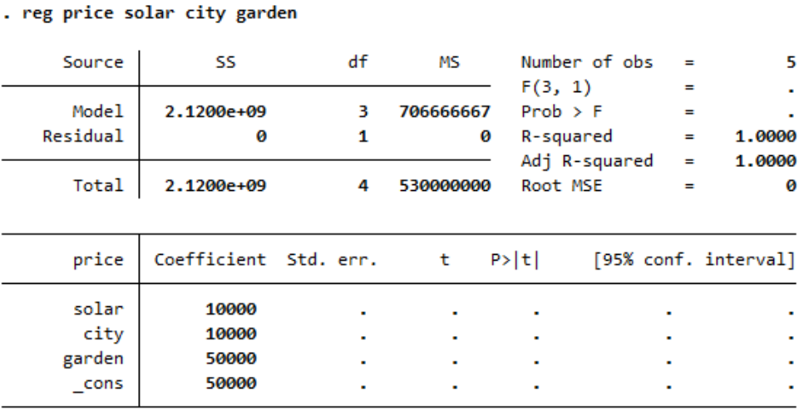
Coefficient and its interpretation

Slide 11
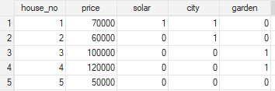
What if price for the house no 4 changed to 120,000

Slide 12
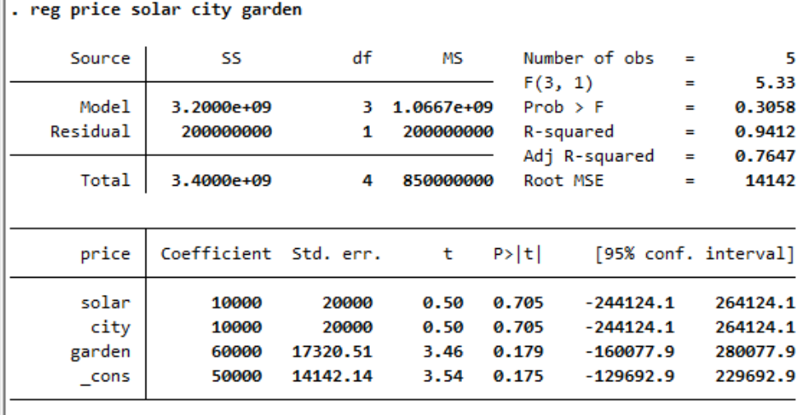

Slide 13
Designing Hedonic pricing model

Slide 14
1. Variables selection
Potential variables are identified based on recent literatures, theories, availability of data.
Visualizing dependent and independent variables to identify a relationship between them.
Let’s use (KIELMC.dta) dataset from the following paper:
Wooldridge Source: K.A. Kiel and K.T. McClain (1995), “House Prices During Siting Decision Stages: The Case of an Incinerator from Rumor Through Operation,” Journal of Environmental Economics and Management 28, 241-255.

Slide 15
From KIELMC.dta, we consider the following variables
year: 1978 or 1981 (initial discussion and rumors in 1978, actual construction began in 1981)
age: age of house
price: house price
rooms: number of rooms in the house
area: square footage of house
land: square footage lot
baths: number of bathrooms
dist: distance from house to incinerator (in feet).

Slide 16
price ~ area

Slide 17
price ~ area

Slide 18
price ~ land

Slide 19
If a variable has extreme values, it could distort the OLS estimates.
In such a case, it is better to
drop those extreme values.
scale down those extreme values.
convert the variable in logarithmic form.
use quantile regression models instead of OLS.

Slide 20
log(price) ~ log(land)

Slide 21
Why we take log?
Generally, we take log of variables with exponential growths such as stock prices, GDP, wages etc.
Why we take log?
To linearize the exponential growth.
Coefficients represent percentage changes.
Easier to calculate elasticities.

Slide 22
price ~ baths

Slide 23
price ~ age

Slide 24
price ~ year

Slide 25
price ~ dist

Slide 26
log(price) ~ log(dist)

Slide 27
price ~ rooms

Slide 28
2. Handling non-linear relationship
OLS assumes that outcome Y and predictor X hold a linear relationship.
If this assumption is invalid, OLS will be a poor fit to data.
Adding a quadratic term to the regression may help.
Examples of non-linear relationships:
CO₂ emission ~ GDP per capita (EKC hypothesis)
Car price ~ life of the car
Worker productivity ~ worker’s age

Slide 29
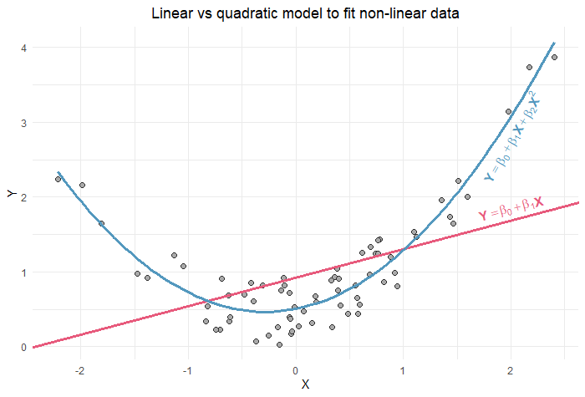

Slide 30
price ~ age

Slide 31
price ~ age

Slide 32
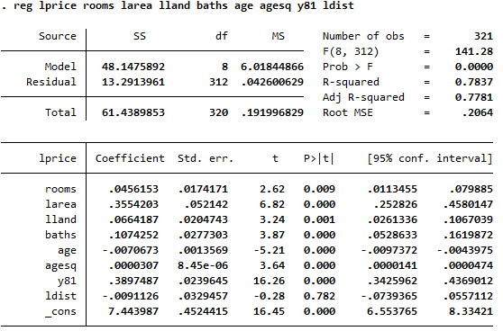
3. Interpreting regression estimates

Slide 33
Significance of the model:
The F-statistic with a p-value less than 1% indicates that the model is statistically significant at the 1% level. This means the joint estimates of the coefficients are statistically not equal to zero.

Slide 34
Model fit:
Independent variables explains 78% of the variation in the log prices.

Slide 35
Root Mean Squared Error (RMSE):
The Root MSE measures the standard deviation of the residuals. Lower values indicate better fit.

Slide 36
Coefficient interpretation:
For each additional room, price increases by 0.046 (4.6%).
1% increase in area is associated with a 0.36% increase in price.
agesq +ve coefficient suggests a non-linear relationship between price and age.

Slide 37
Coefficient interpretation:
The coefficient of 0.3897 for the dummy variable y81 suggests that, on average, houses are priced 38.97% higher compared to house prices in 1978.
All the coefficient estimates are statistically significant at 1% except for ldist.

Slide 38
4. Model estimate visualization
In a well-fitted model, the predicted values and the actual values of the dependent variable should closely align along a 45-degree line (i.e. x=y).

Slide 39
In a residual plot, residuals should not exhibit any pattern and should randomly scattered around y=0 line.

Slide 40
A well-fitted model should have a normally distributed residuals.

Slide 41
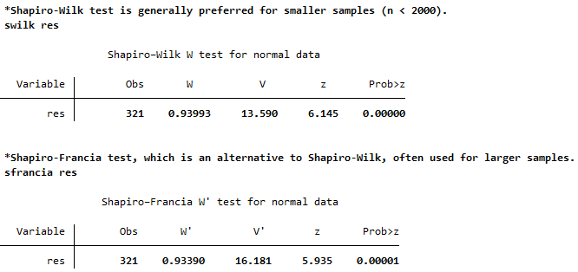
Formal test of residual normality
However, in real world, it is challenging to obtain residuals that are normally distributed because including all the relevant factors that influence the dependent variable might not be possible.

Slide 42
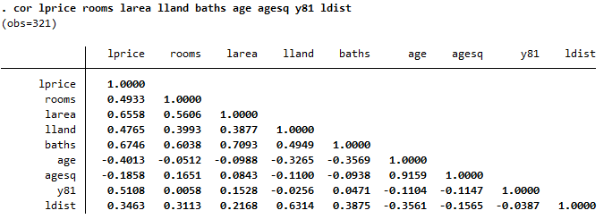
5. The problem of multicollinearity
We should not use independent variables that are highly correlated to each other as this can lead to a multicollinearity problem, which can result in biased and unreliable estimates.
According to the above correlation matrix, it is better to drop baths and ldist from the model specification.

Slide 43
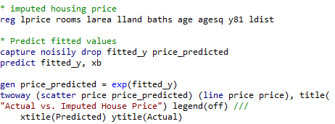
6. The imputed house prices

Slide 45
Quantile Regression as an alternative to Hedonic Pricing

Slide 46
Benefits of quantile regression
Varying effects on different quantiles: OLS calculates conditional means only. QR shows how relationships change across different quantiles.
Outlier Influence: Mitigates the influence of outliers. Useful for skewed or heavy-tailed data
Non-Normal Errors: OLS assumes normally distributed errors. Quantile regression does not.

Slide 47
Quantile regression (q=0.5)
RMSE = 0.2072

Slide 48
Quantile regression (q=0.1)

Slide 49
Quantile regression (q=0.9)

Slide 50
Thank You

